Slide 1

Mountkirk Games
Group 7
(6M13)

Slide 2
Introduction
Mountkirk Games makes online, session-based, multiplayer games for mobile platforms. They have recently started expanding to other platforms after successfully migrating their on-premises environments to Google Cloud.
Their most recent endeavour is to create a retro-style first-person shooter (FPS) game that allows hundreds of simultaneous players to join a geo-specific digital arena from multiple platforms and locations.
A real-time digital banner will display a global leader board of all the top players across every active arena.

Slide 3

Executive Statement
Our last successful game did not scale well with our previous cloud provider, resulting in lower user adoption and affecting the game’s reputation. Our investors want more key performance indicators (KPIs) to evaluate the speed and stability of the game, as well as other metrics that provide deeper insight into usage patterns so we can adapt the game to target users.
Additionally, our current technology stack cannot provide the scale we need, so we want to replace MySQL and move to an environment that provides autoscaling, low latency load balancing, and frees us up from managing physical servers.

Slide 4
Xonotic by Mountkirk Games
Xonotic is an arena style first person shooter (FPS) with fluid movement and a wide arsenal of weapons
Hosted on Google Cloud Platform
Free to play with many exciting game modes

Slide 5

Solution Concept
Mountkirk Games is building a new game, which they expect to be very popular. They plan to deploy the game’s backend on Google Compute Engine so they can capture streaming metrics, run intensive analytics, and take advantage of its autoscaling server environment and integrate with a managed NoSQL database.

Slide 6

Requirements
Business:
Supports multiple gaming platforms and regions
Supports the rapid iteration of game features
Minimise latency
Dynamic scaling
Minimise costs by using pooled resources and services
Technical:
Scale based on game activity
Real-time global leaderboard
Store game activity logs in structured databases for analysis
Server-side rendering for multi-platform support
Support future-proofing for eventual migration of legacy games

Slide 7
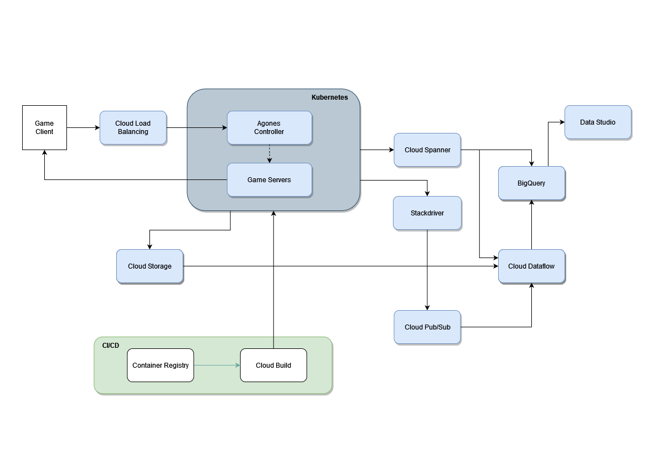
Design Architecture

Slide 8
Google Kubernetes Engine- Backend Setup for Xonotic
Two clusters running in two primary regions (us-central and europe-west)
Lightweight and scalable containers to support future migration and expansion
Cluster version to support iteration of future game features
Load Balancing and Agones help to distribute client requests between the multi region clusters
Autoscaling enabled to cater to traffic demand. Manual upgrading of Kubernetes cluster
Declarative configuration (e.g YAML) enable easier,more modular migration and expansion for similar games

Slide 9
Creating GKE us cluster
Create a cluster in the us-central region:
gcloud container clusters create usa-xonotic \
--cluster-version=1.20 \
--tags=game-server \
--scopes=gke-default \
--num-nodes=2 \
--no-enable-autoupgrade \
--machine-type=e2-standard-2 \
--zone=us-central1-a

Slide 10
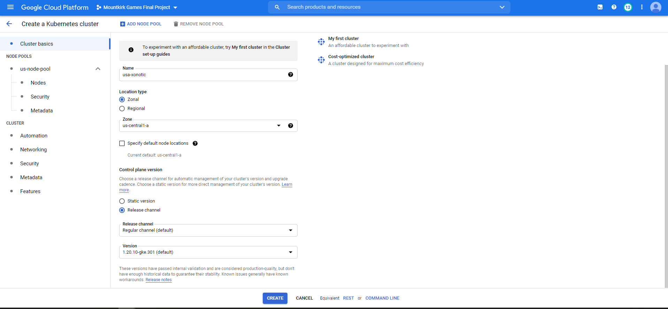
GKE- us central cluster

Slide 11
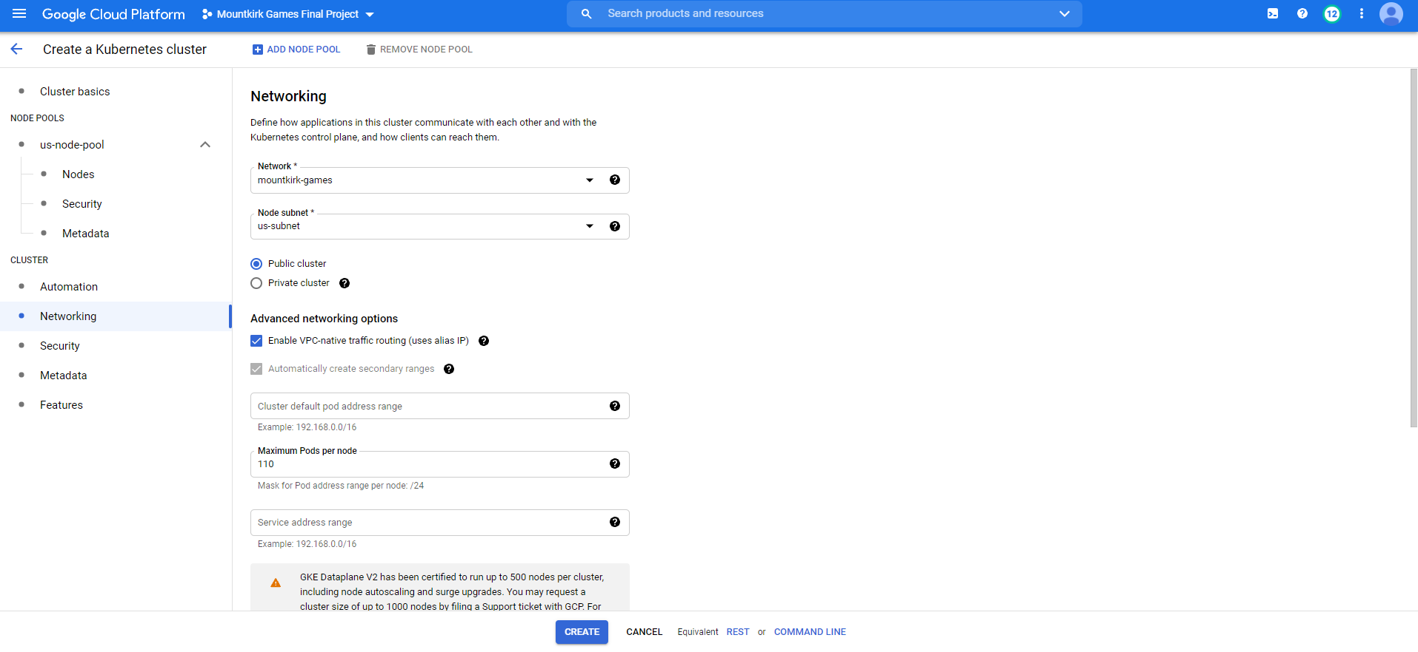
GKE- custom us subnet
Notes:
Hosted on custom network with a subnetwork that belongs to the appropriate region

Slide 12
Creating GKE europe cluster
Create a cluster in the europe-west region:
gcloud container clusters create eu-xonotic \
--cluster-version=1.20 \
--tags=game-server \
--scopes=gke-default \
--num-nodes=2 \
--no-enable-autoupgrade \
--machine-type=e2-standard-2 \
--zone=europe-west1-b

Slide 13
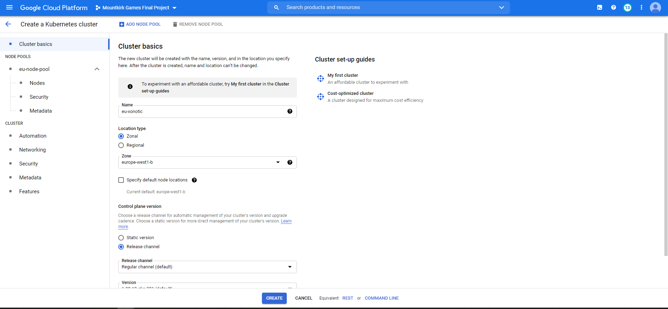
GKE- europe west cluster

Slide 14
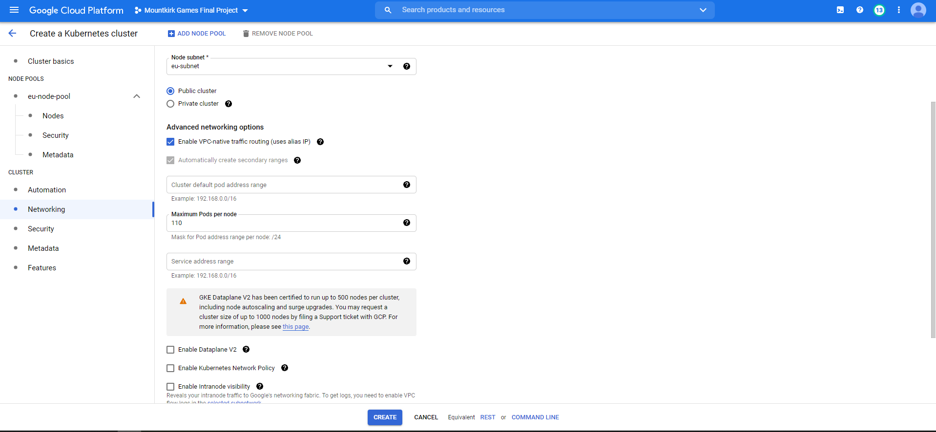
GKE- custom eu subnet

Slide 15
Details of VM running inside GKE Clusters
We chose E2-Standard2 as the VM machine type to provide enough hardware performance to avoid game lagging, and headroom for any future expansion.
Multiples instances running on the same underlying, local hardware which will eliminates the need for hardware accumulation and excessive overhead.
It’s also provide safety net for data as they can be used to enable rapid disaster recovery and automatic backups.

Slide 16
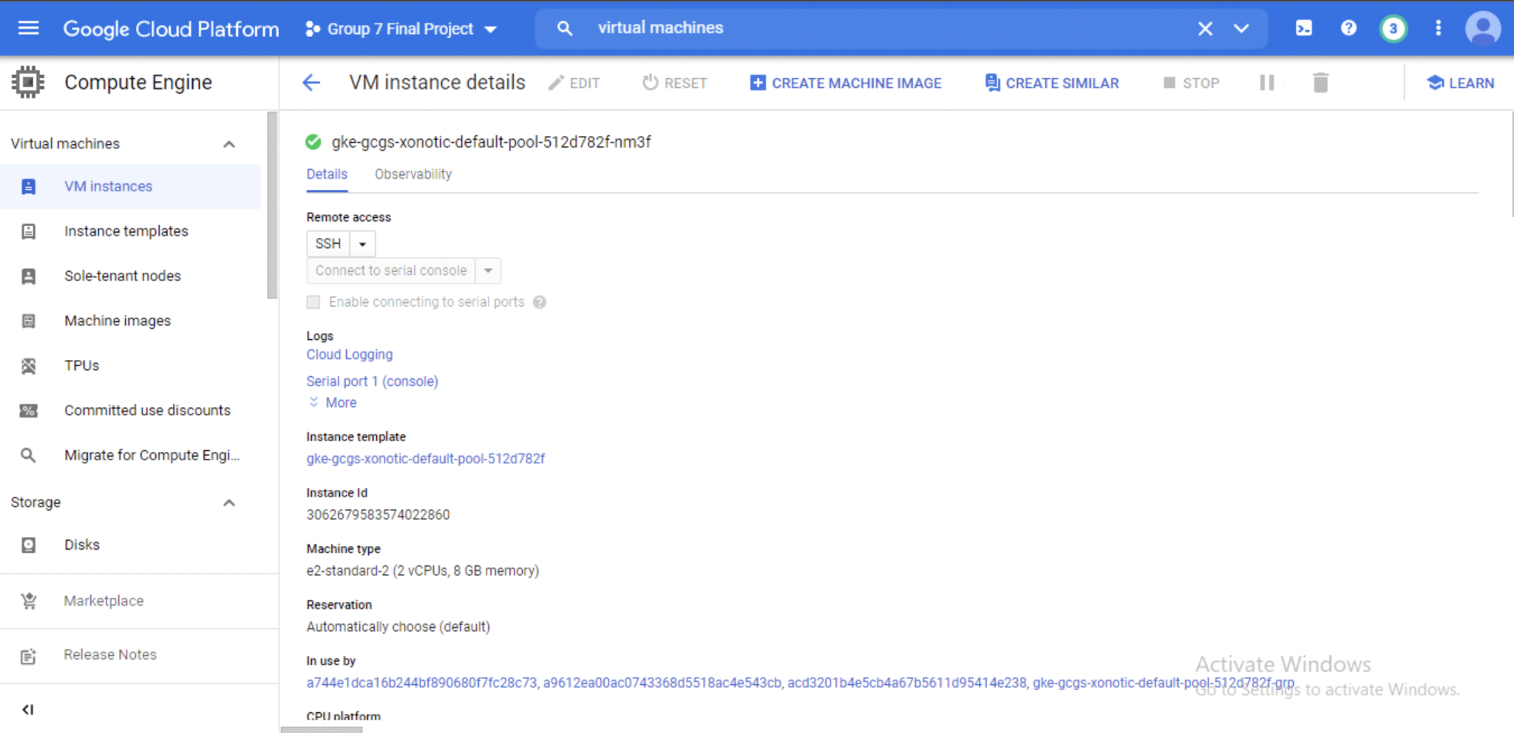
Example VM
Notes:
We choose e2 standard to provide enough computing hardware to game server to avoid lagging and be able to handle increase requirements.

Slide 17
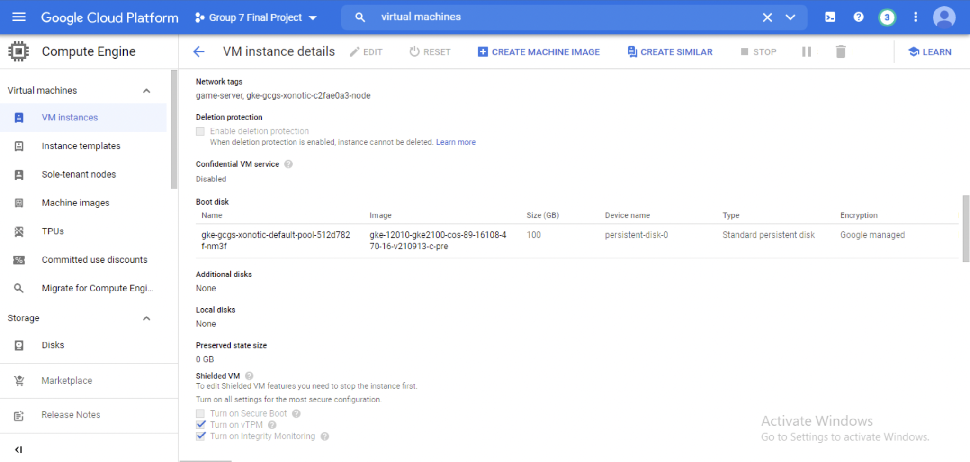
Example VM
Notes:
30GB is standard

Slide 18
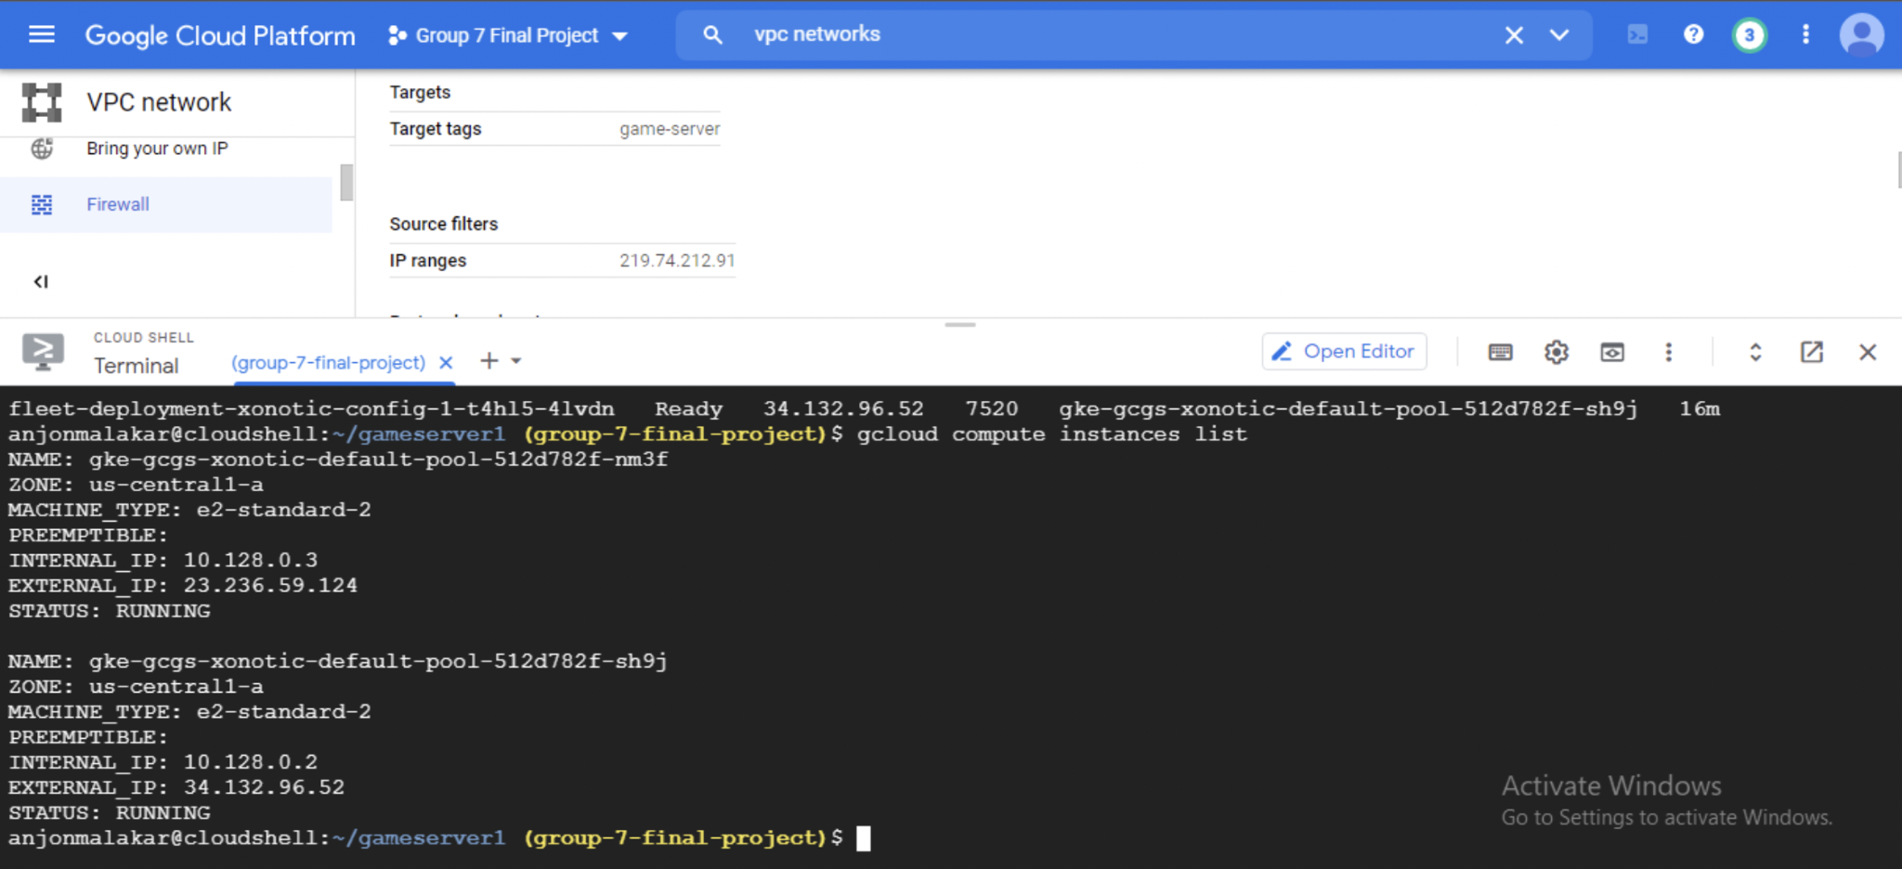
Example CLI
Notes:
They both have external IP so its ready to connect to the game players to the regions

Slide 19

Why use Agones?
For deploying, scaling, and orchestrating dedicated game servers for multiplayer games, using Kubernetes.
Makes Kubernetes “game-aware” so that it avoids interrupting game sessions.
Better cluster management and game server scaling.
Able to conveniently manage game servers in “fleets”.
Works with GCP Game Services API.
Open-source platform, free.

Slide 20
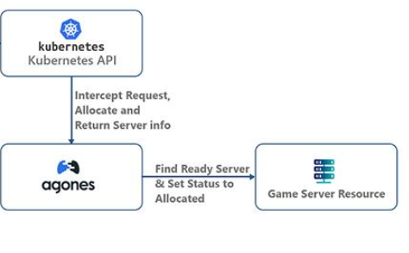
Agones diagram

Slide 21
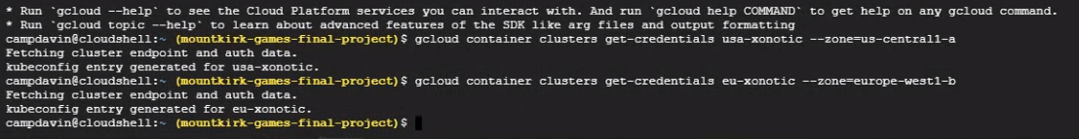
Agones - Installing on GKE
1. Getting credentials for US and EU Kubernetes clusters
2. Creating a namespace:
kubectl create namespace agones-system
3. Installing Agones on GKE cluster:
kubectl apply -f https://raw.githubusercontent.com/googleforgames/agones/release-1.17.0/install/yaml/install.yaml

Slide 22
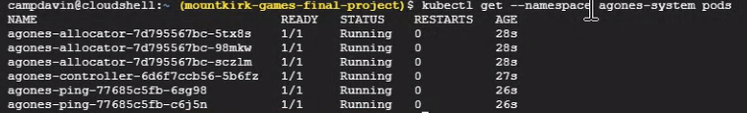
Successful Agones deployment:

Slide 23
Creating Game Server realm
4. Creating an Game Server realm in the same region as GKE cluster:
gcloud game servers realms create realm-xonotic \ --time-zone US/Central --location us-central1

Slide 24
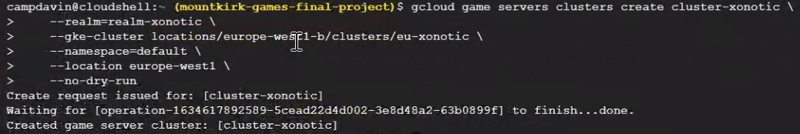
Creating Game Server cluster
5. Creating Game Server cluster, attaching to realm, registering GKE cluster:
6. Creating a Game Server deployment:
gcloud game servers deployments create deployment-xonotic

Slide 25
YAML for Creating Agones fleet
- name: fleet-spec-1
fleetSpec:
replicas: 2
template:
metadata:
labels:
xonotic-game-server-v1-label-key: xonotic-game-server-v1-label-1
spec:
ports:
- name: default
containerPort: 26000
template:
spec:
containers:
- name: xonotic
image: gcr.io/agones-images/xonotic-example:0.8
saved as xonotic_fleet_configs.yaml

Slide 26
YAML for Configuring Agones Fleet autoscaling
- fleetAutoscalerSpec:
policy:
type: Buffer
buffer:
bufferSize: 1
maxReplicas: 4
name:
scaling-config-1
saved as xonotic_scaling_configs.yaml

Slide 27
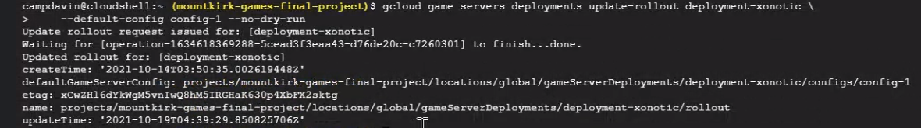
Game servers configuration using YAML and rollout
7. Game servers configuration:
gcloud game servers configs create config-1 \
--deployment deployment-xonotic \
--fleet-configs-file xonotic_fleet_configs.yaml \
--scaling-configs-file xonotic_scaling_configs.yaml
8. Update rollout to deployment:
gcloud game servers deployments update-rollout deployment-xonotic \
--default-config config-1 --no-dry-run

Slide 28
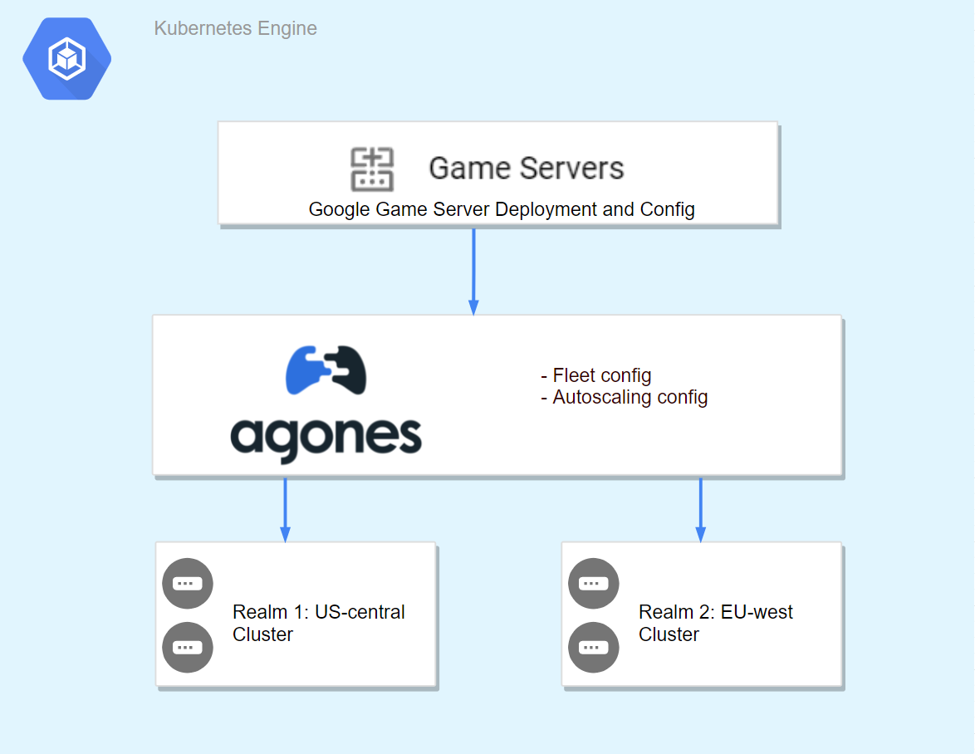
Overall Kubernetes setup

Slide 29
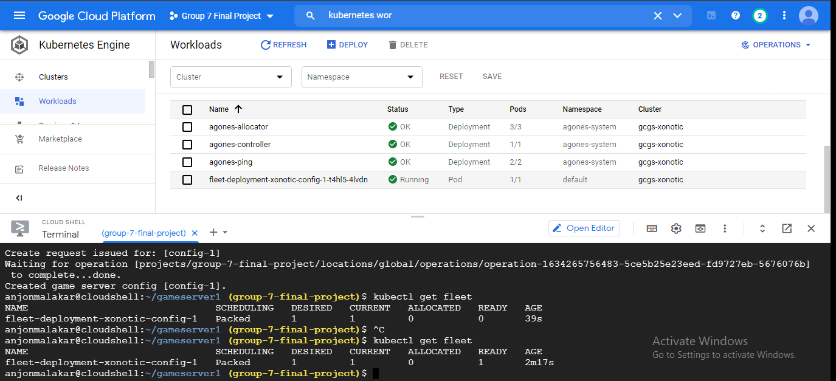
Successful Agones Fleet Deployment

Slide 30
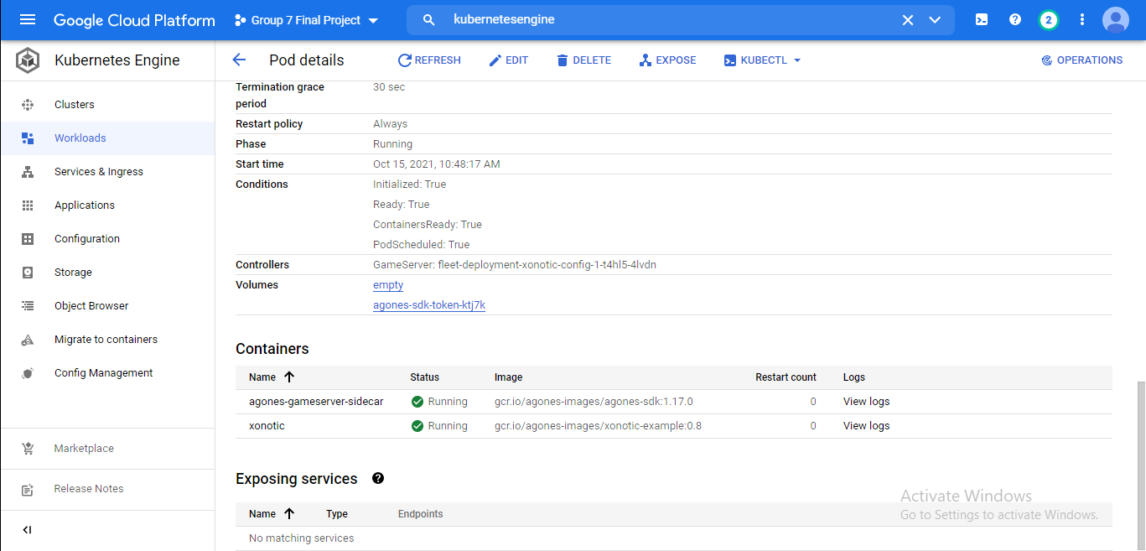
Successful Pod running game server

Slide 31
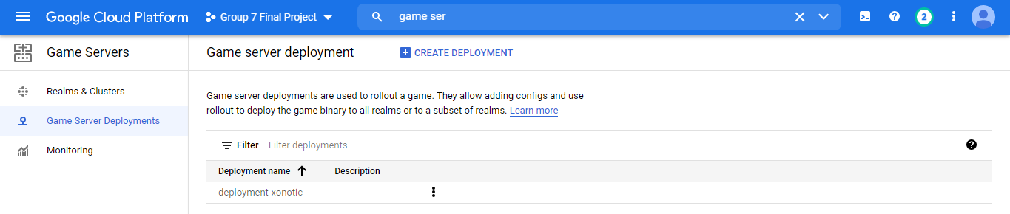
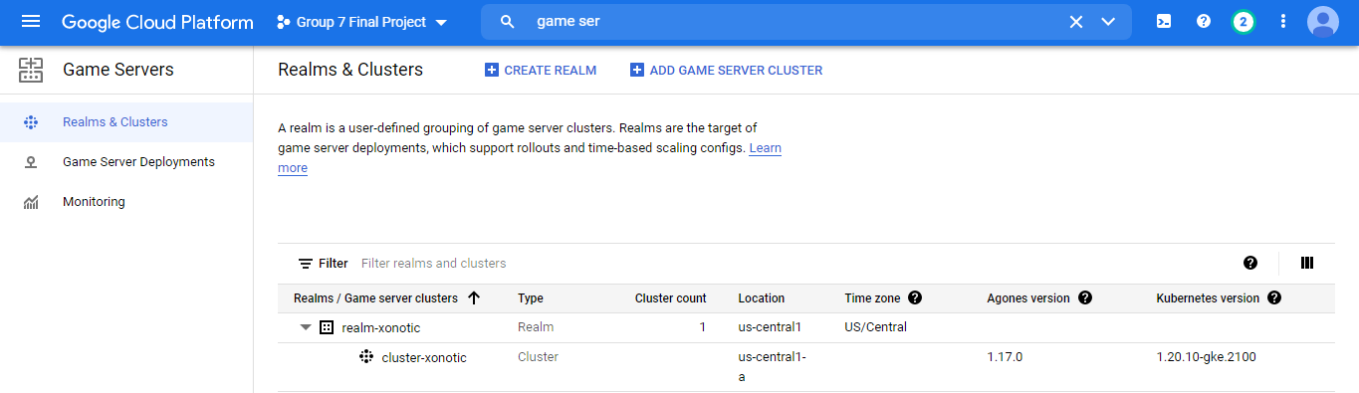
Game servers details

Slide 32
VPC Network Setup for Xonotic
Create a dual region VPC network
Using Source IP ranges 0.0.0.0/0
Using 3 custom firewall rules
With 2 custom subnets

Slide 33
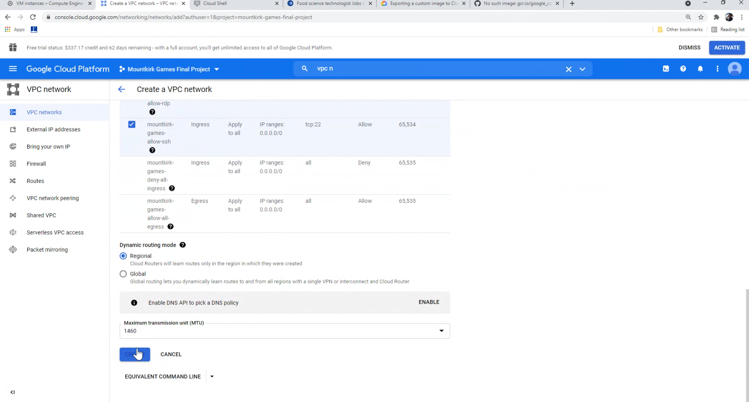
Custom VPC network

Slide 34
Load Balancing Setup for Xonotic
Protocol: Regional TCP
Network Tier: Premium
Regions: US central and EU west
Healthcheck completed: k8s-c4bb733550a8cc6d-node

Slide 35
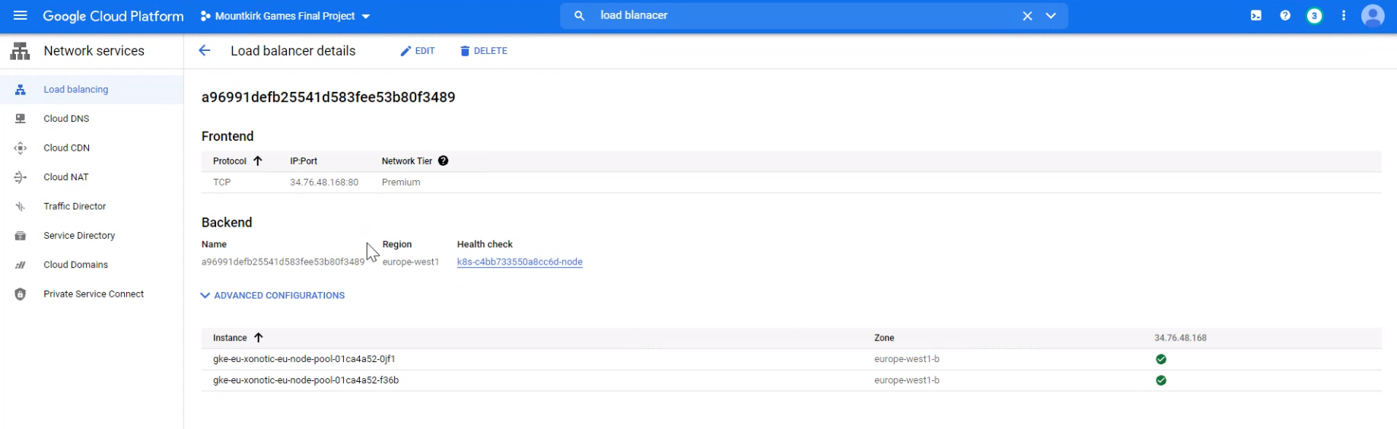
Regional TCP Load Balancer

Slide 36
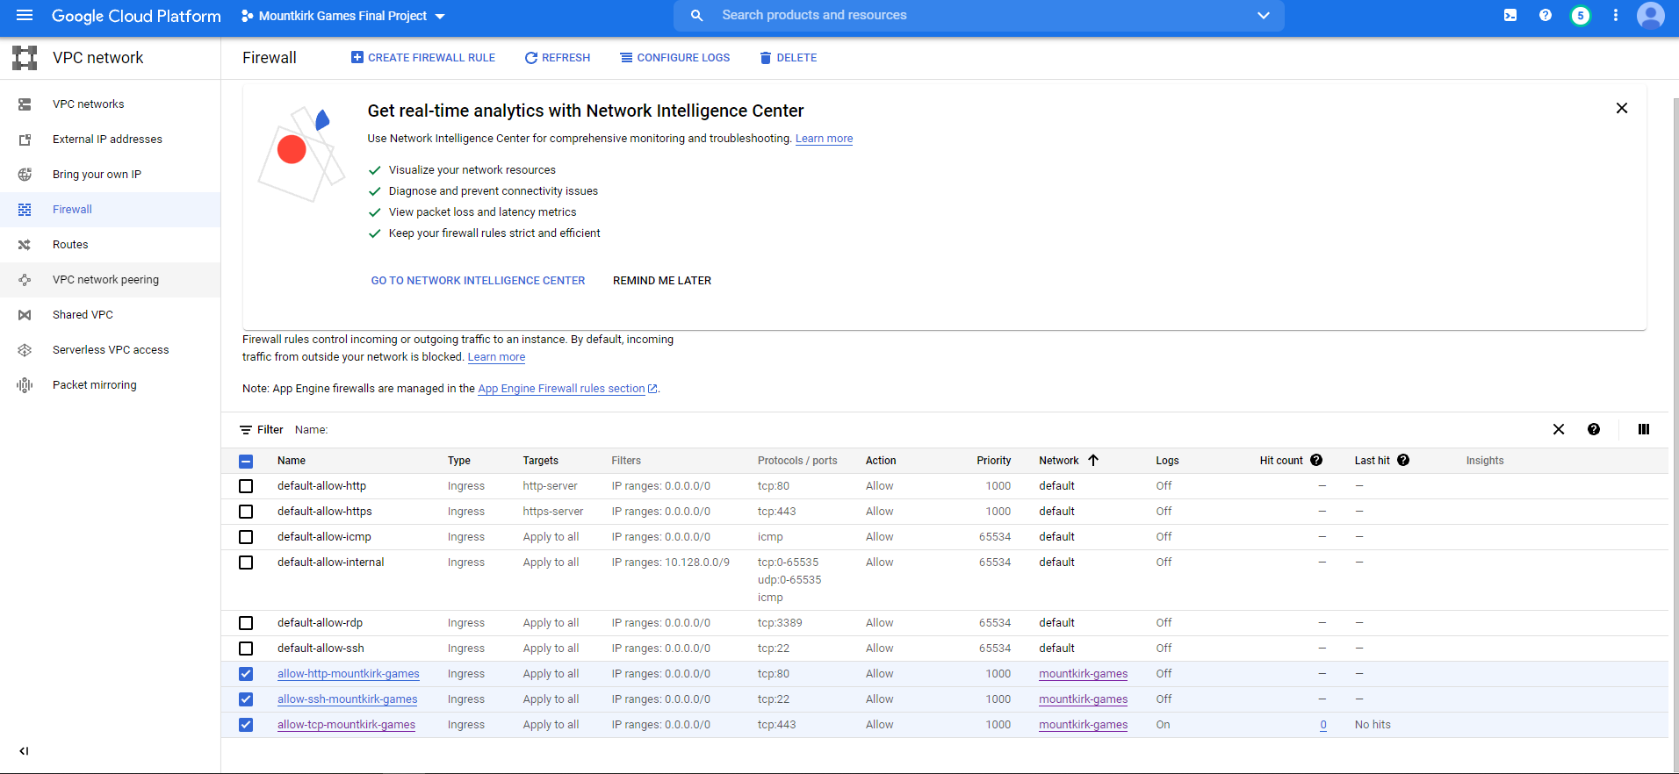
Firewall rules for custom network

Slide 37
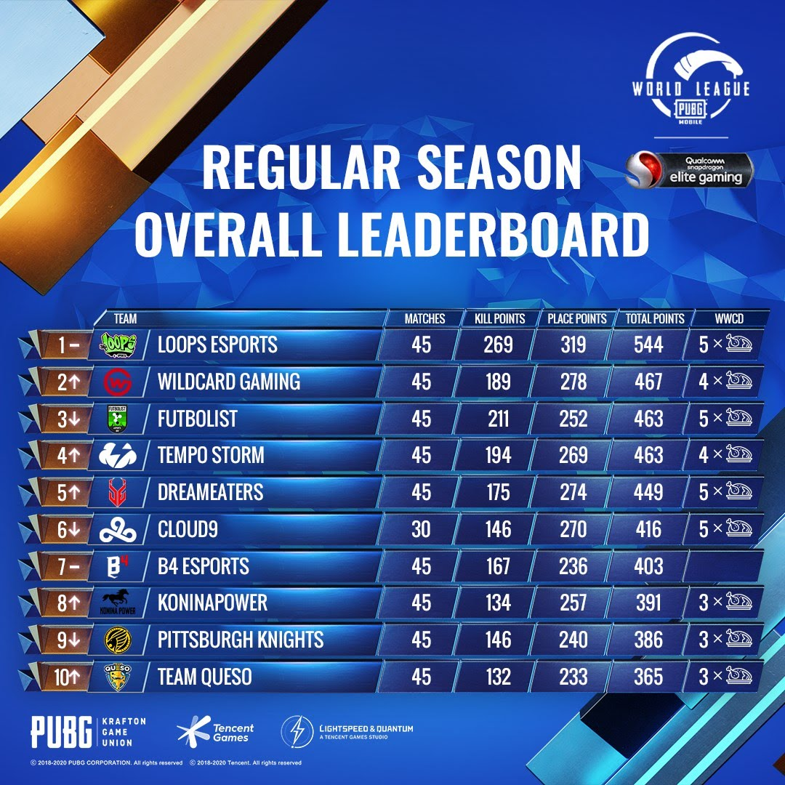
Technical Requirement
A real-time digital banner will display a global leader board of all the top players across every active arena.

Slide 38

Proposed Solution
Cloud Spanner
Provides optimal balance between Scalability, Consistency and Availability.
Spanner is used in the gaming industry to support real-time game play and end-game purchases that are driving revenues.
Popular games can attract millions of global users at launch who demand interactive gameplay that’s always online.

Slide 39
Why Cloud Spanner
This burst of high volume real time traffic can be ‘game over’ for common databases.
A gamer from Iowa, USA immediately visible to his opponent in London, UK, typically requires manual database sharding in order to scale.
Database maintenance windows are also a big risk! With global players and multiple franchises, it can be impossible to schedule downtime to patch the database or update schema to support new capabilities.

Slide 40
Why Cloud Spanner
Therefore for gaming, Spanner is fully managed and never needs to be paused for patches, backups, failover, or even schema updates.
Using Google’s dedicated infrastructure, Spanner guarantees consistency and zero planned downtime, even at the most extreme scale. Which translates into better gameplay and satisfied customers.

Slide 41
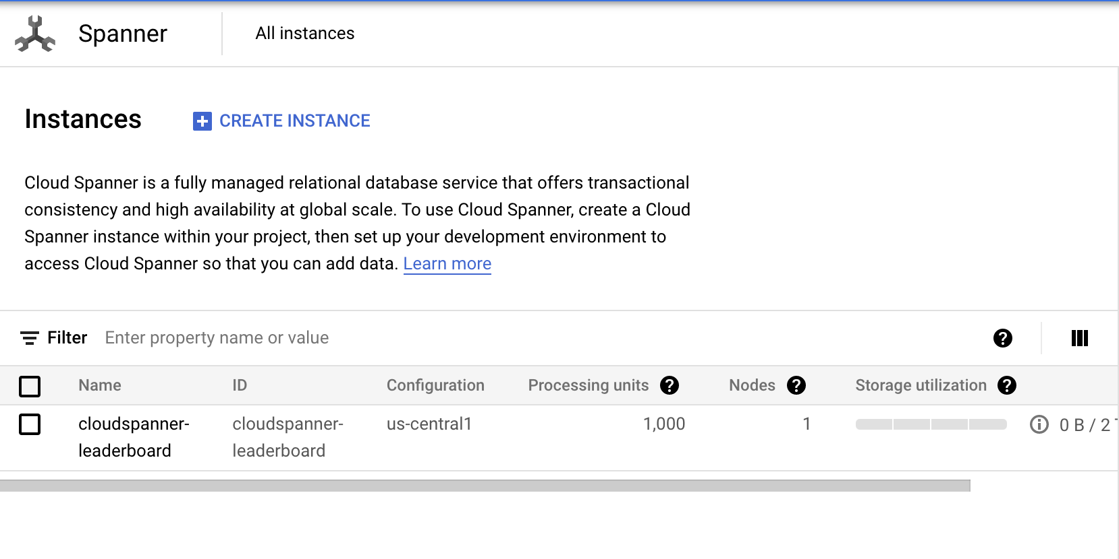
Created a Gaming Leaderboard
Created an instance in Spanner

Slide 42
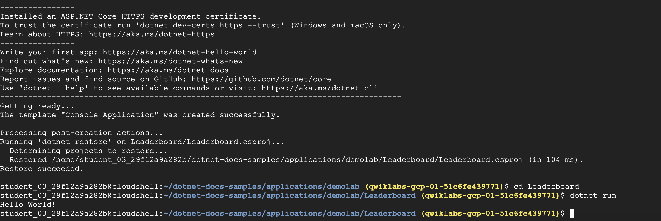
Created Leaderboard using C+ client library from Github

Slide 43
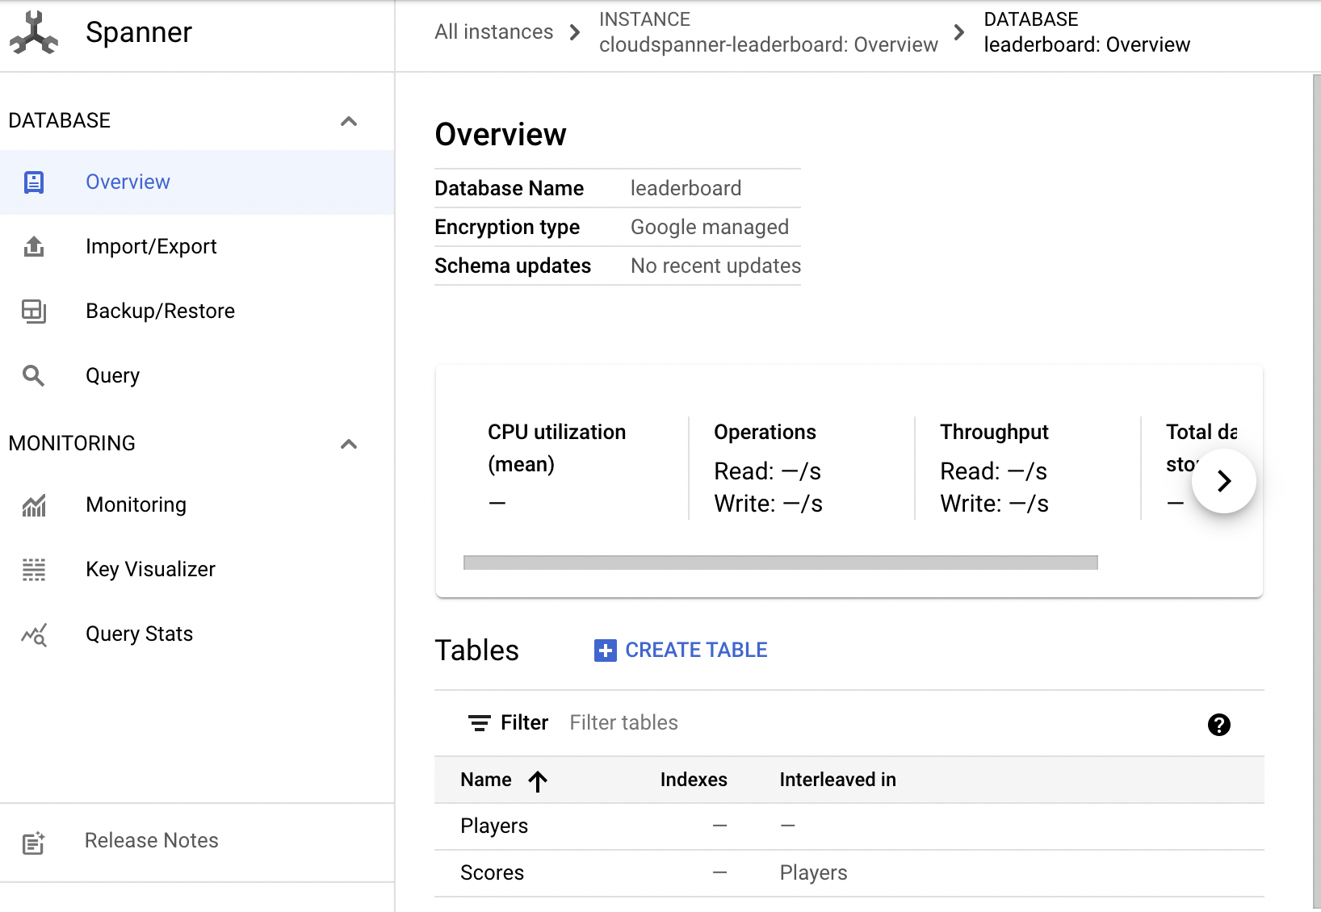
Create a Database and Schema
Created a Player and Scoring table
Player info.
Storing player scores.

Slide 44
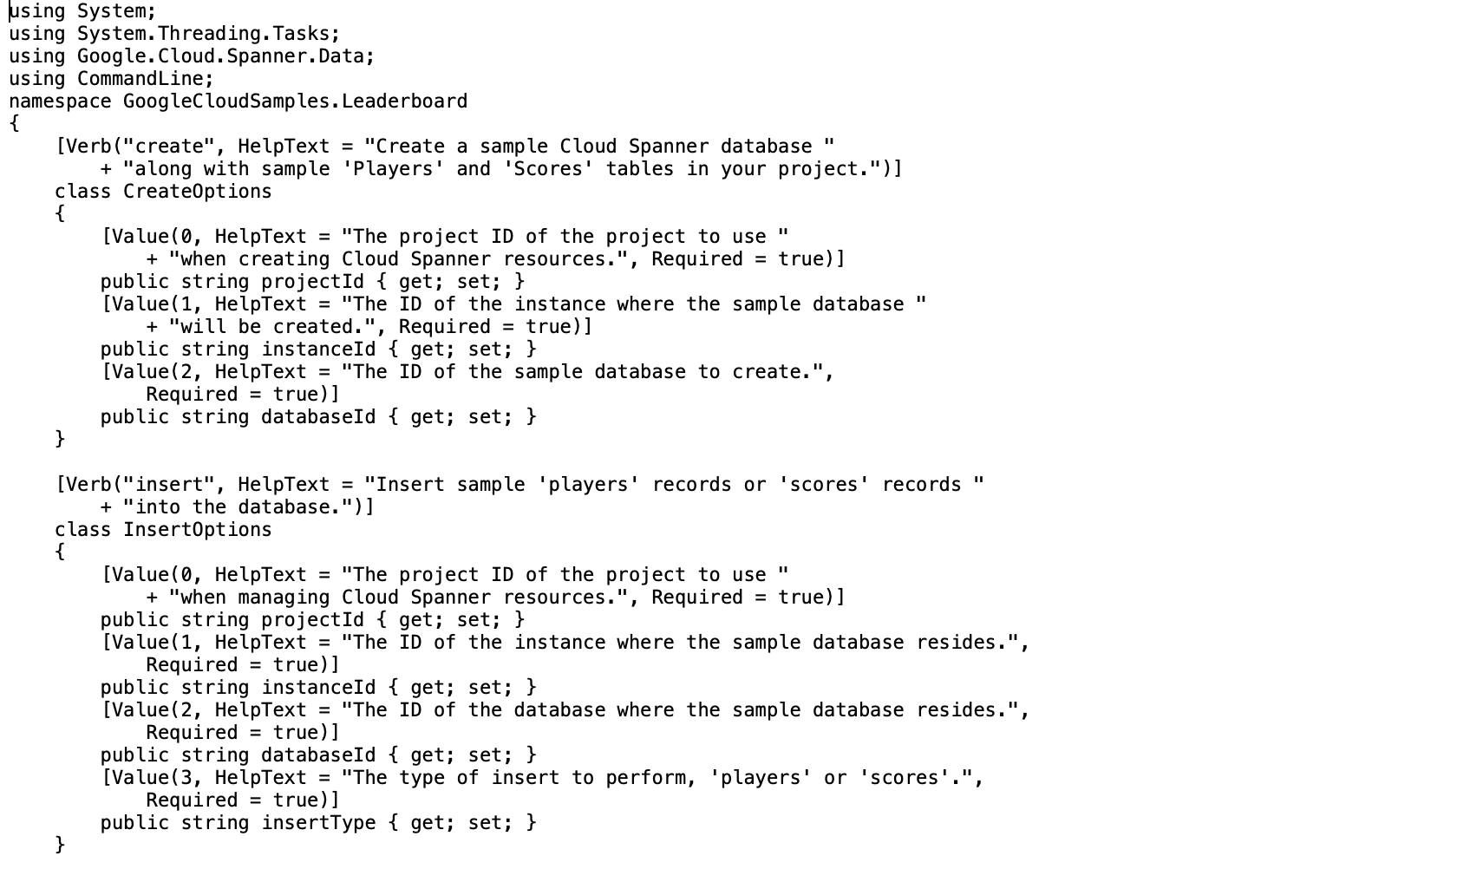
Created a Database and Schema by Inserting code in program.cs

Slide 45
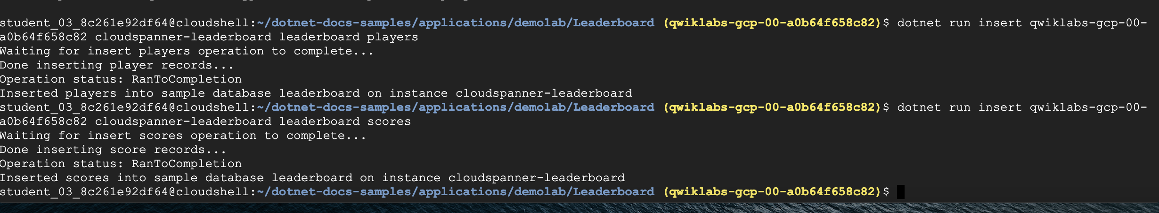
Inserted Players and Scores on Cloud Shell

Slide 46
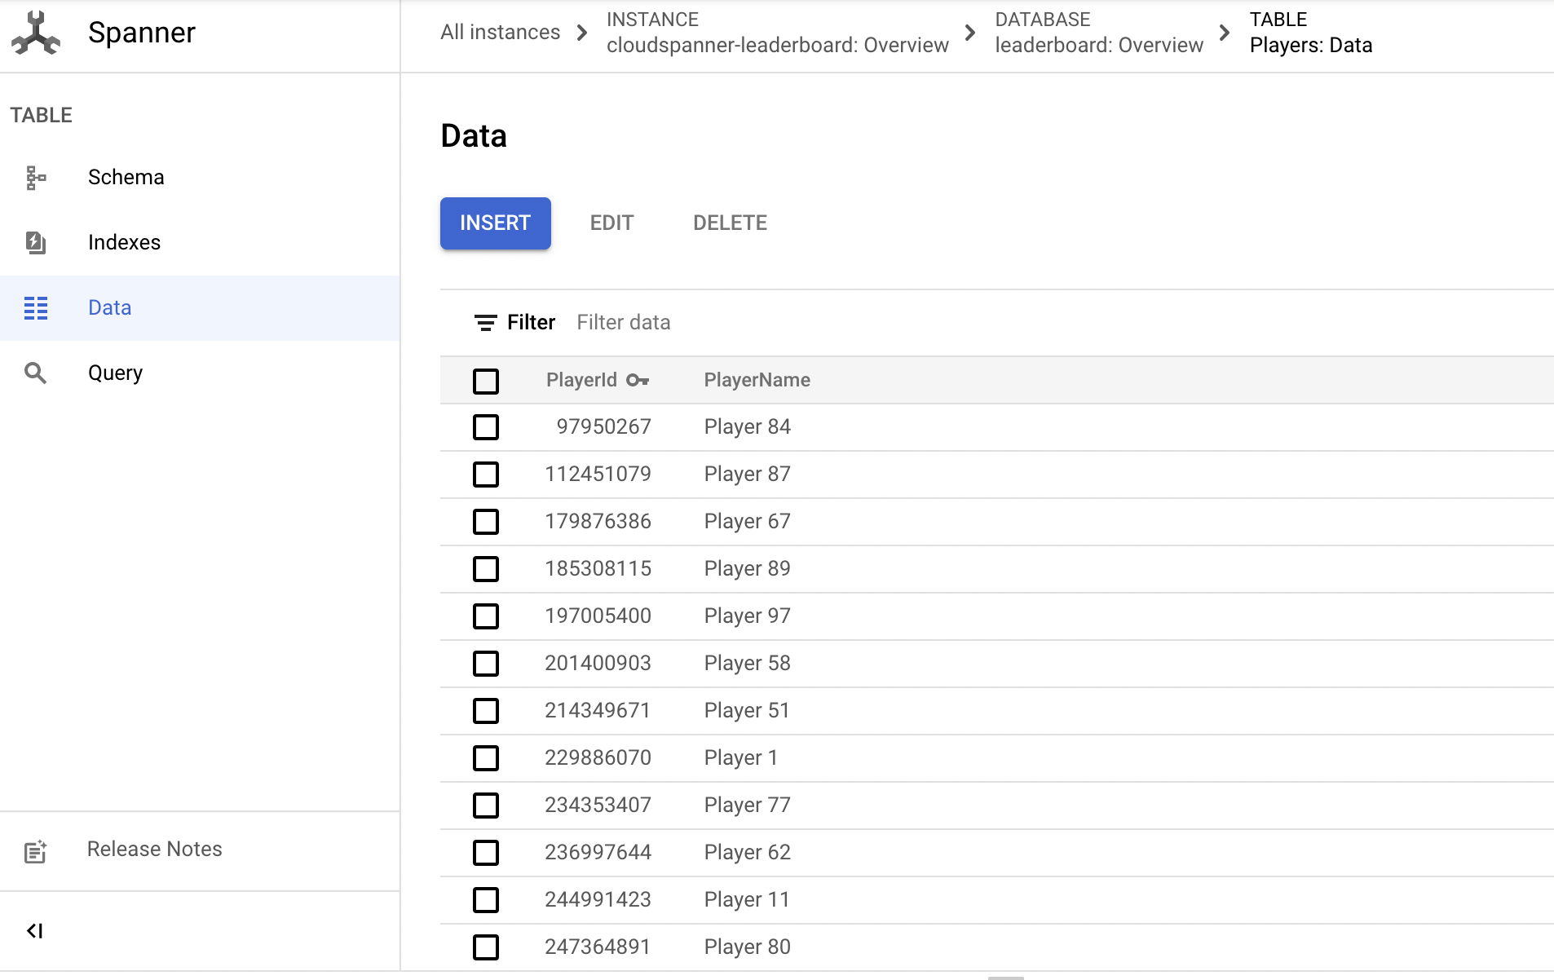
Player Data Created on Leaderboard

Slide 47
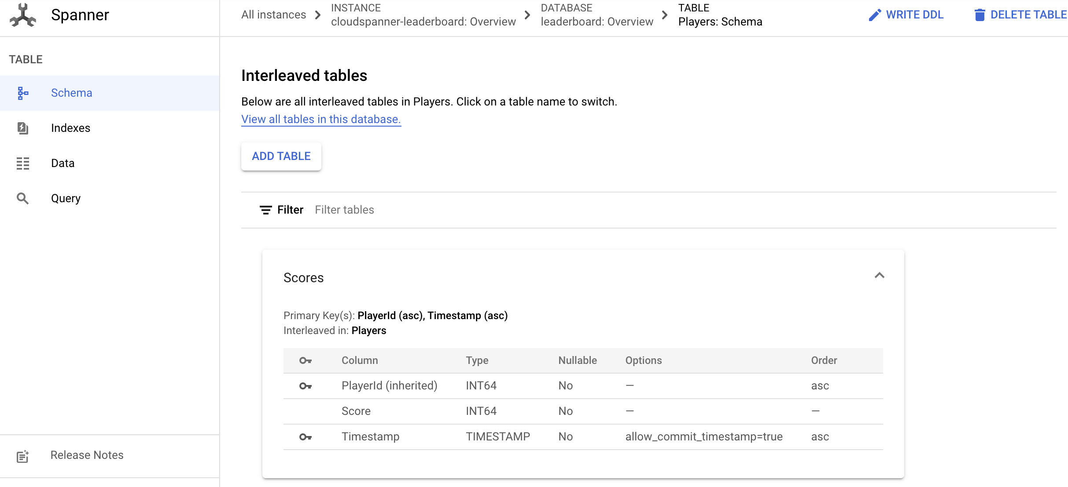
Timestamp Created for Live Scores on Leaderboard

Slide 48
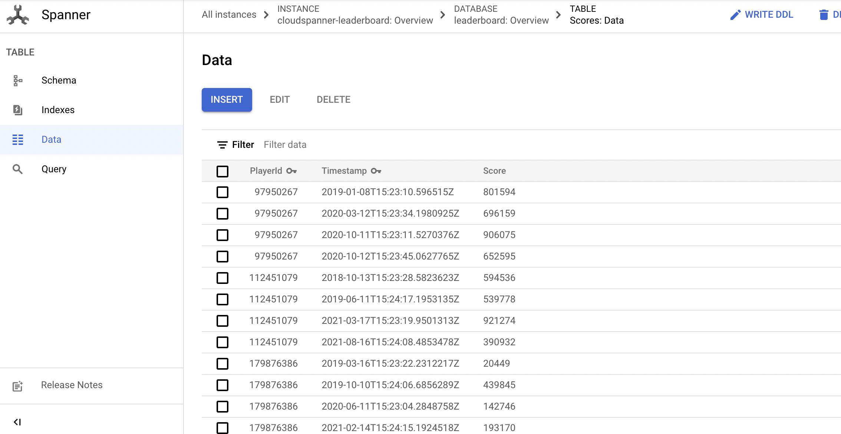
Score Data Created for Live Scores on Leaderboard

Slide 49
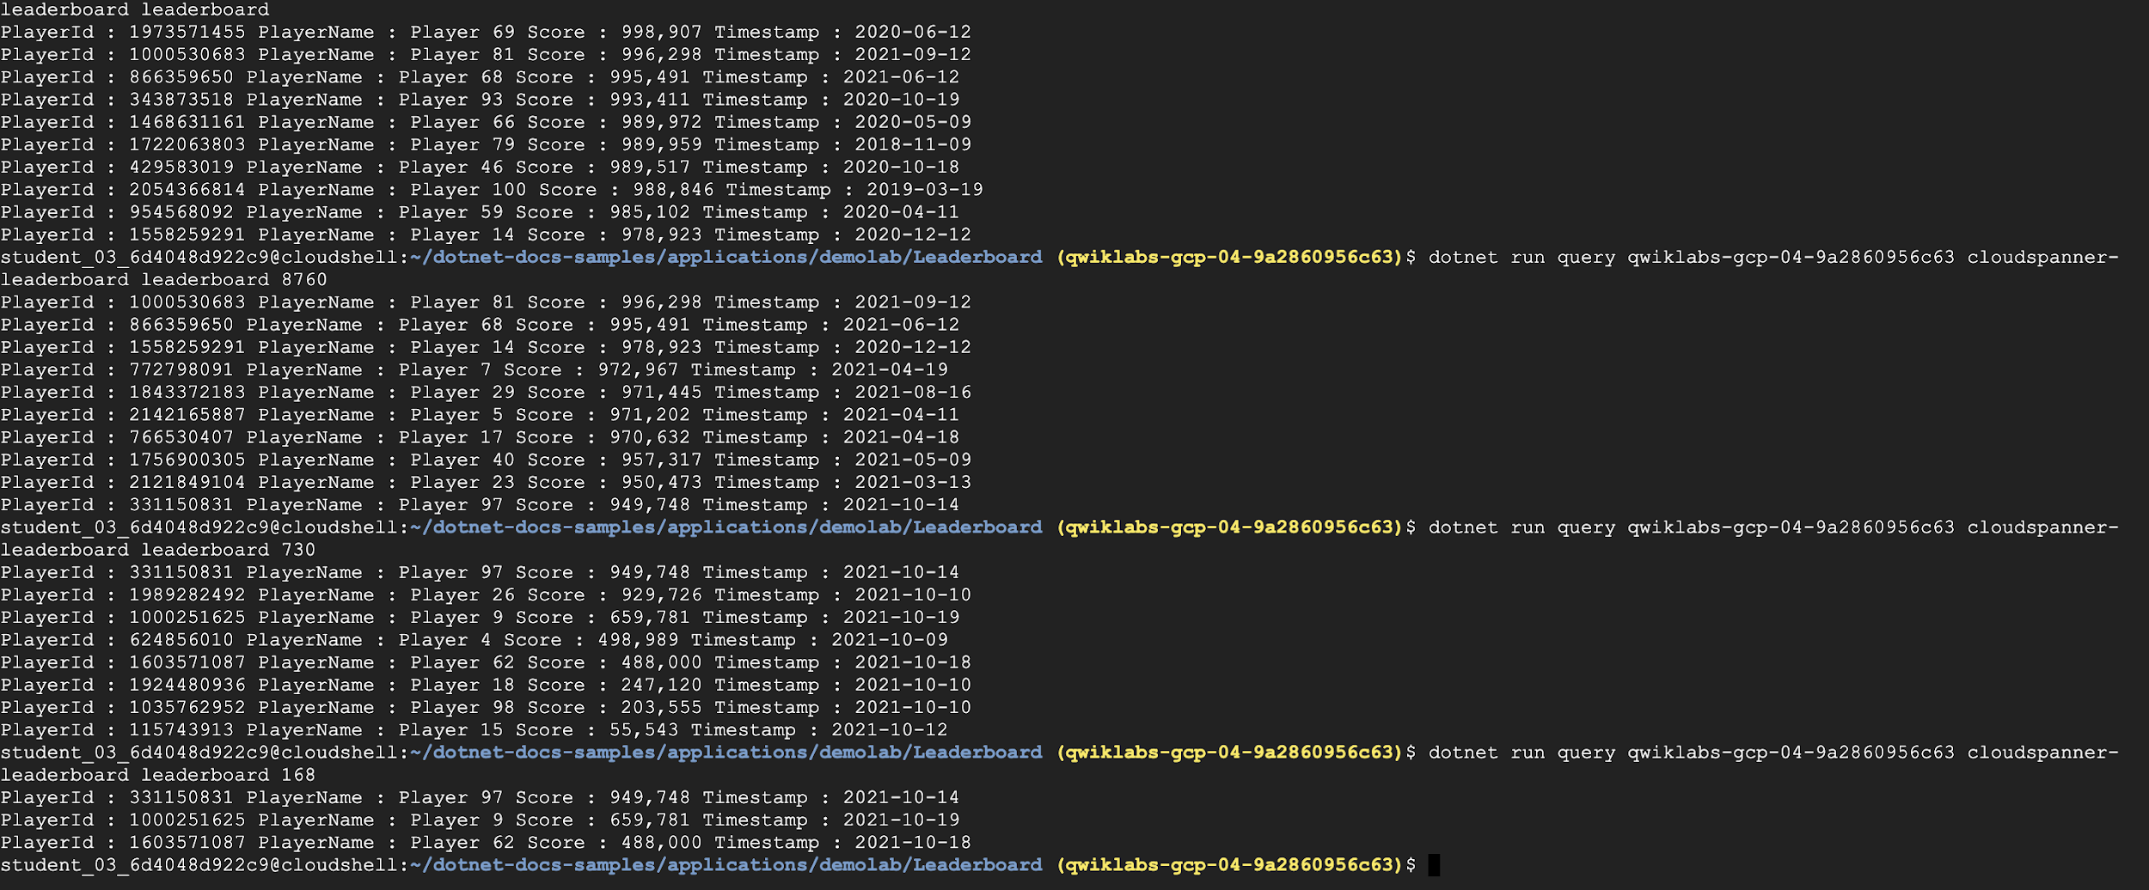
Ran Query to get Live Scores
Highest Scores of the Year
Highest Scores of the Day

Slide 50
Stackdriver - Monitoring and Logging
To keep track of what is happening to the GKE clusters and the containers
Logging is a fully managed service that performs at scale and can ingest application and platform log data, as well as custom log data from GKE environments, VMs, and other services inside and outside of Google Cloud.
Cloud Monitoring provides visibility into the performance, uptime, and overall health of cloud-powered applications. Collect metrics, events, and metadata from Google Cloud services, hosted uptime probes, application

Slide 51
User data
Go to logging
Under logs explorer, in resource, select Kubernetes Container, select Xonotics project
Details pertaining to the user data will be stored there.
Query
“resource.type="k8s_container" resource.labels.cluster_name="gcgs-xonotic"”
Notes:
Log all the game interactions

Slide 52
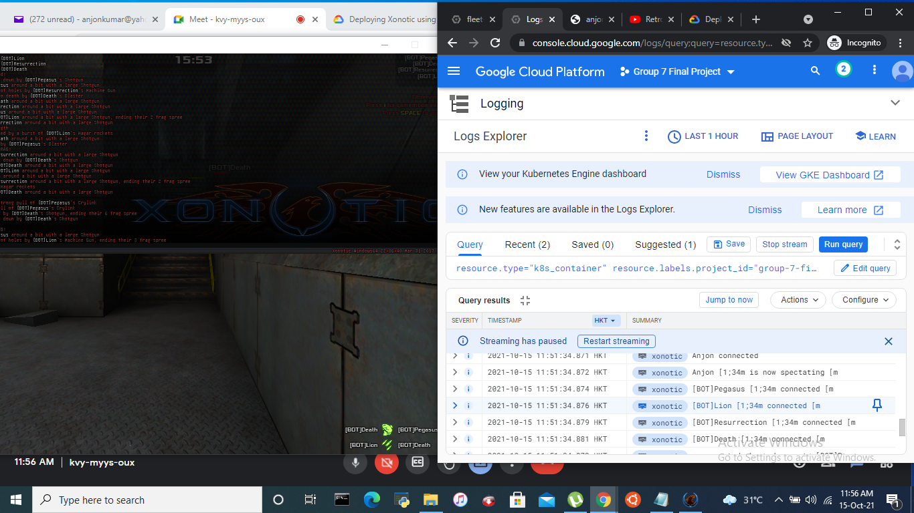

Slide 53
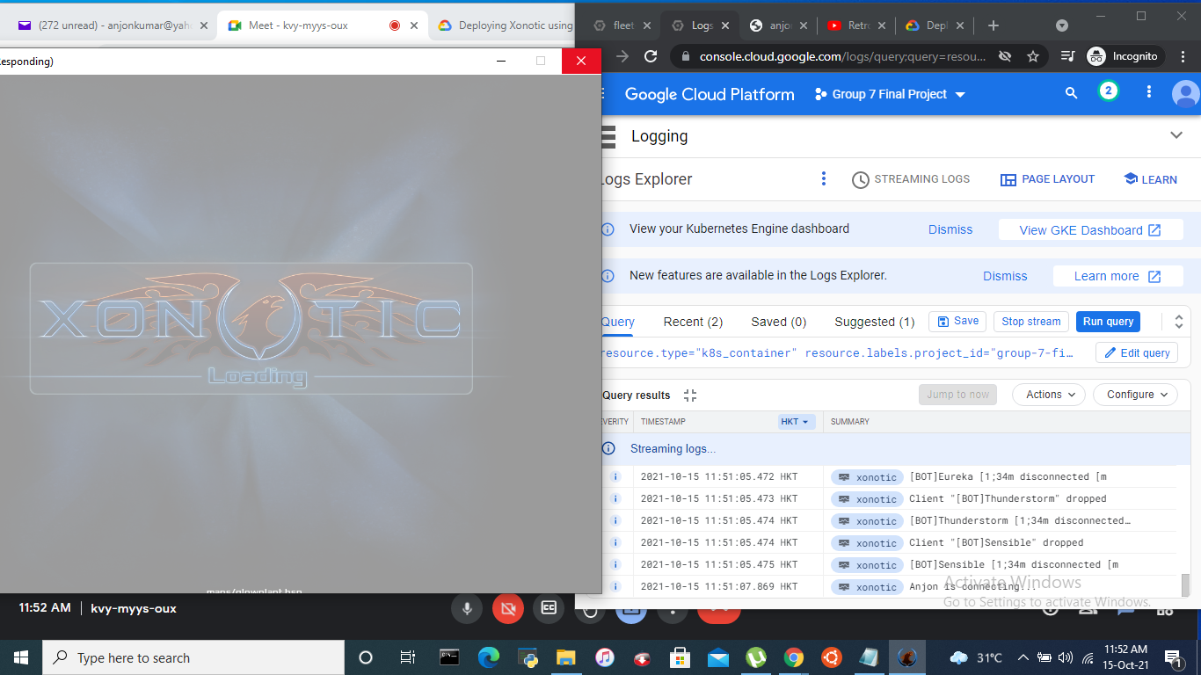

Slide 54
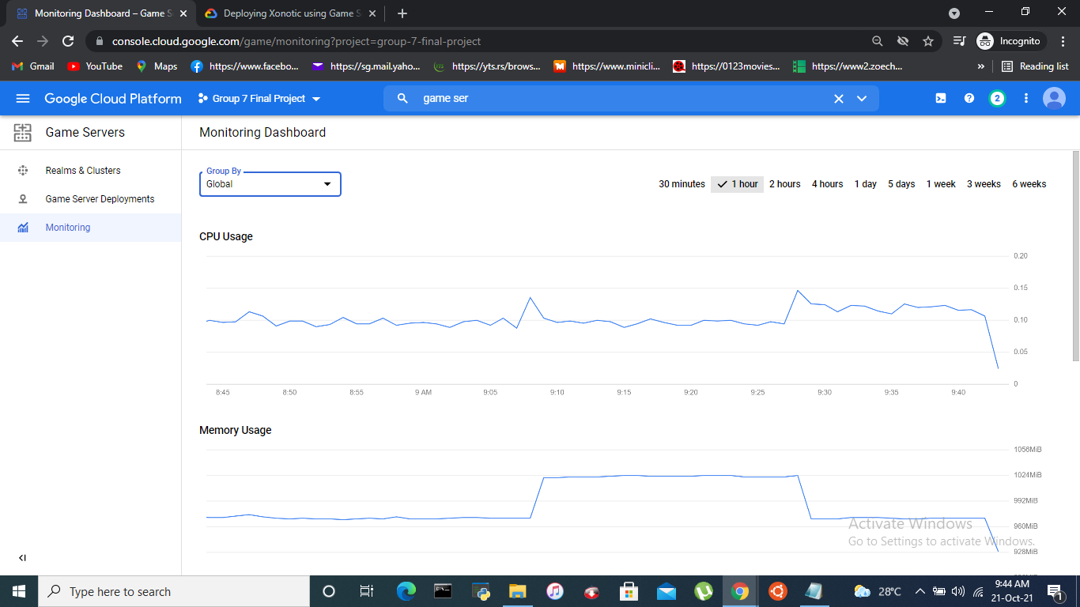

Slide 55
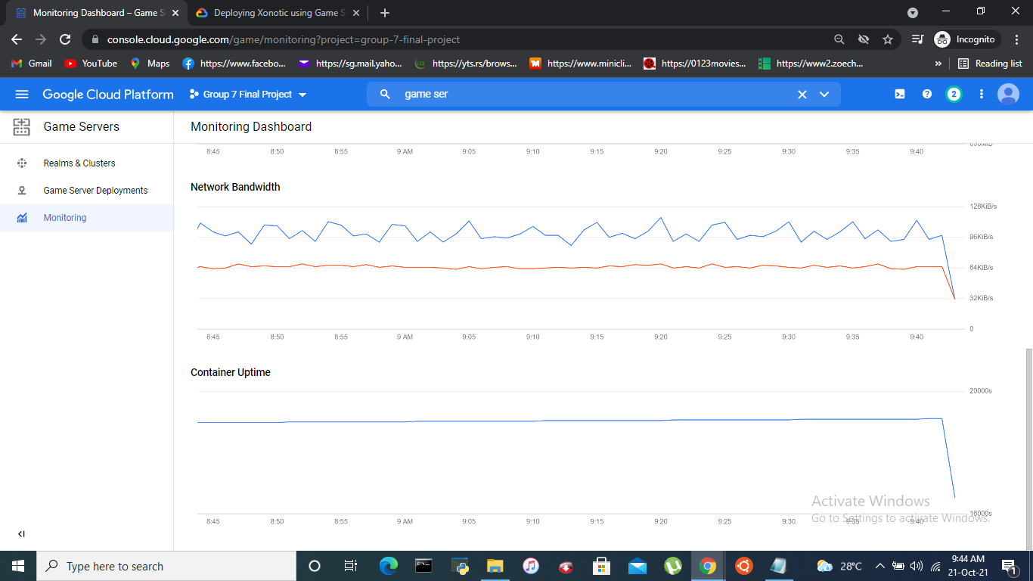

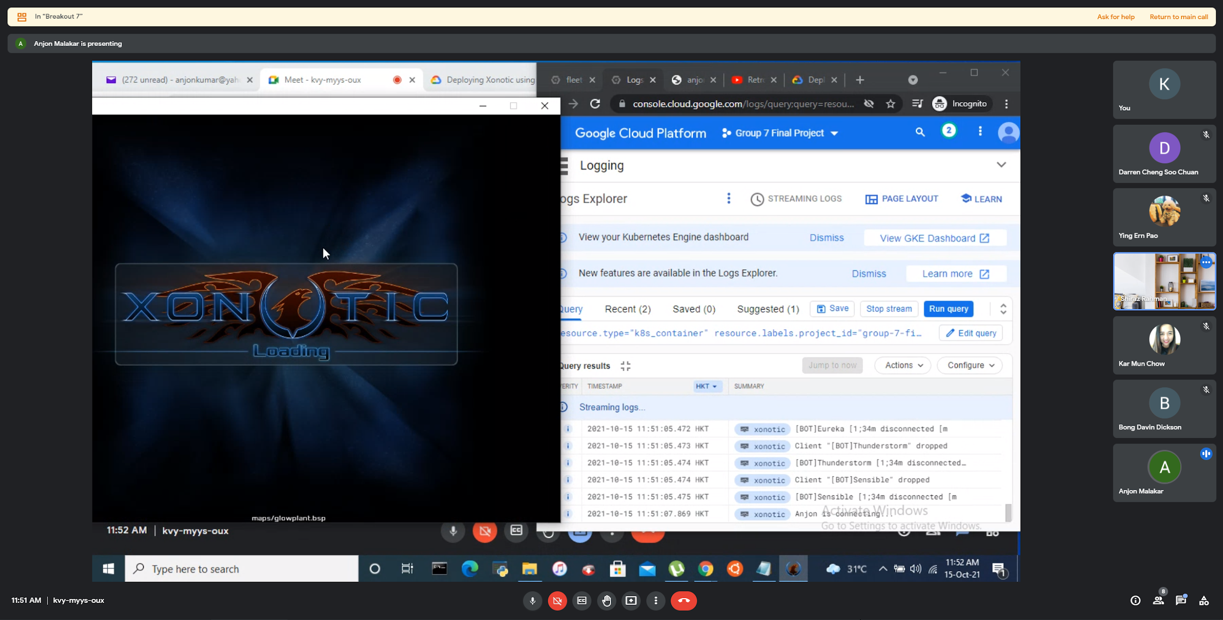

Slide 56
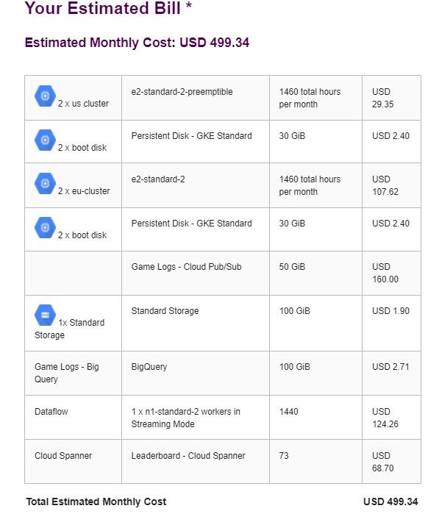
Billing
GKE (with persistent disk)
Cloud Pub/Sub
Cloud Storage
BigQuery
Cloud Spanner
Dataflow
Notes:
Reasonable given that the game has potential, quite fast to get the latency. E2-standard-2 is selected based on number of Virtual Machine. Each Virtual Machine is assigned to 1 Virtual CPU.
With different clusters, people can get faster latency when they play on their respective local servers

